Slide 1
Algoteq Brown Bag series
Pilot Episode - Apache Ignite

Slide 2
Ignite - what’s that?
A distributed database - can hold data on multiple physical machines
Key-value pairs storage (Redis style), with optional SQL access
Distributed transactions supported
In-memory-centric, with optional persistence
Written in Java

Slide 3

So… what?
So it’s just a Java-written in-memory database… right?
Y waste our time then?!?!!!

Slide 4
Because…
because OFF-HEAP
… because DATA COLOCATION & FAILOVER
… because INTEGRATED SERVICES

Slide 5
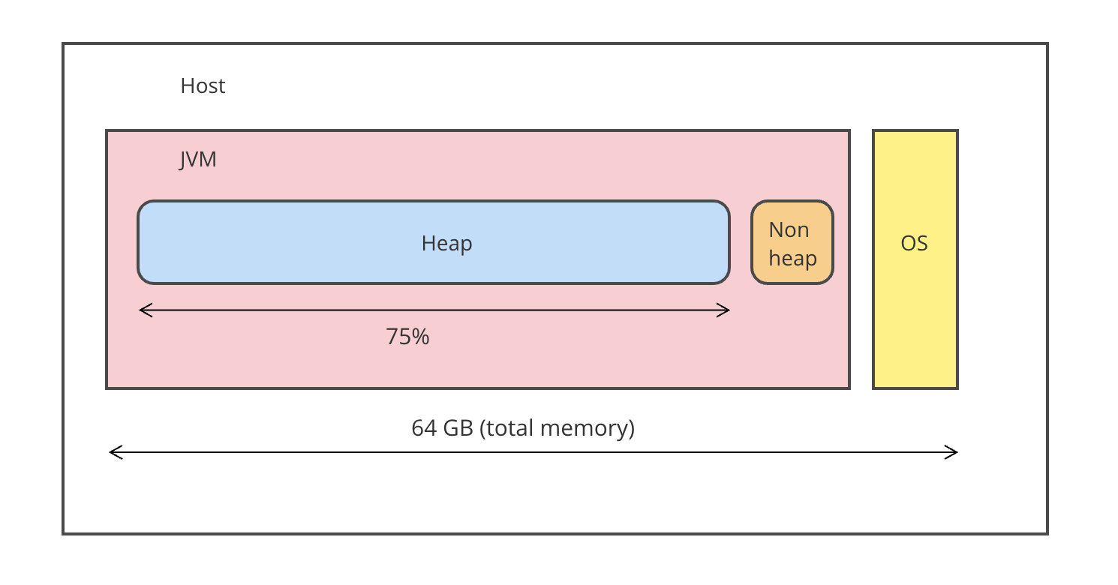
Typical Java server

Slide 6
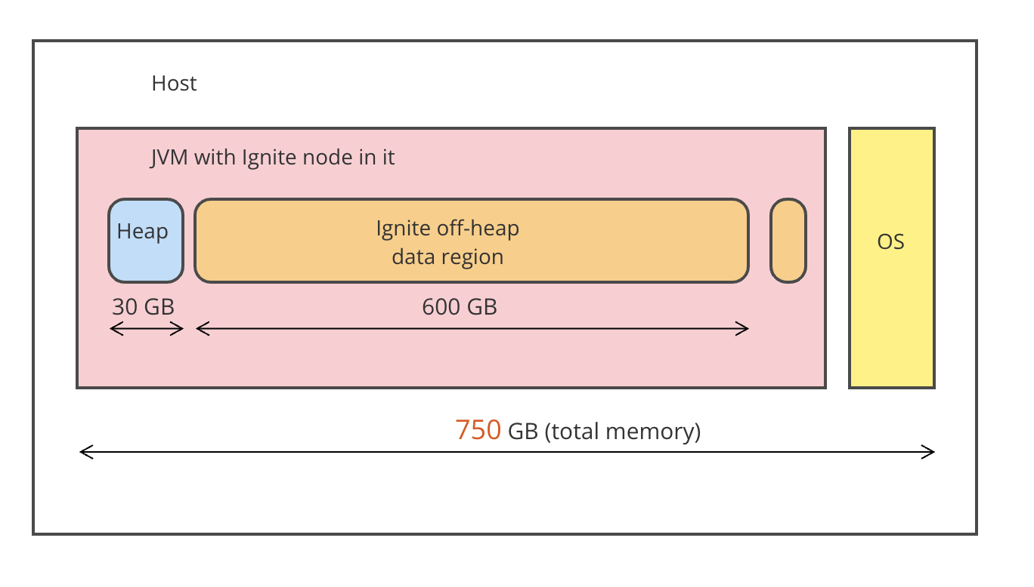
Single (!!!) PROD Ignite node

Slide 7
Show me the code
(code) (code)(code) (code)(code)(code)(code) (code)(code) (code)(code) (code)(code)(code) (code)(code)(code)(code) (code)(code)(code)(code)(code) (code)(code)(code)(code)(code)(code)

Slide 8
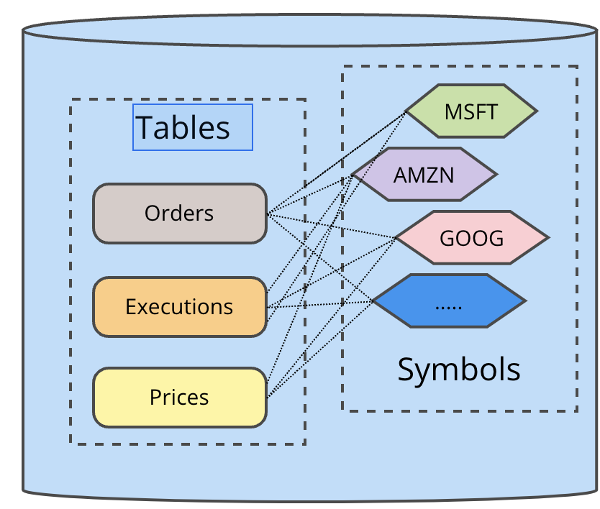
Data colocation - why
Consider millions of fast-ticking records here:

Slide 9
Data colocation - why

Slide 10
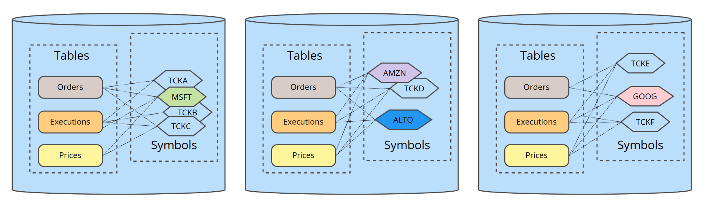
Data colocation - that’s why (A)

Slide 11
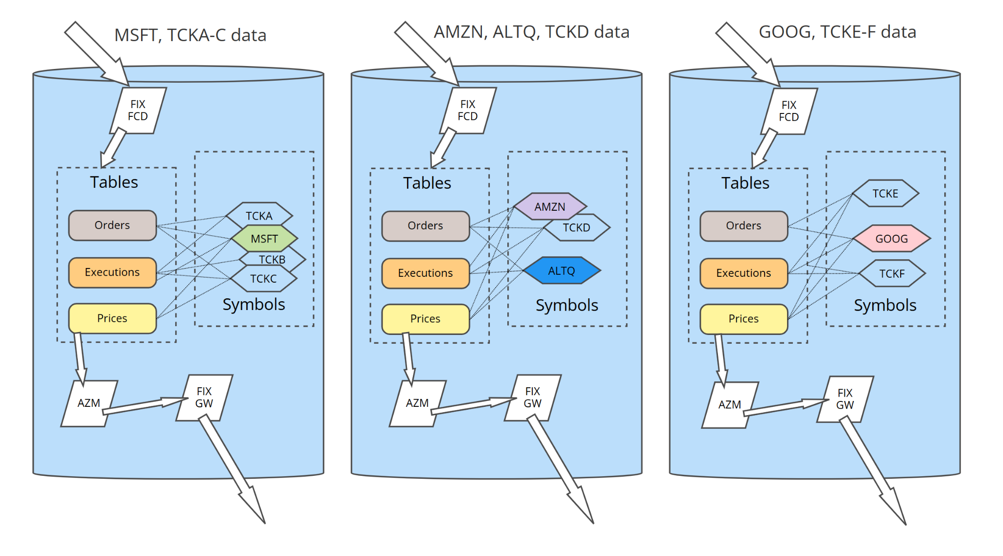
Data colocation - that’s why (B)

Slide 12
Colocation - how
Ignite caches can have one of two mode:
REPLICATED
- or -
PARTITIONED

Slide 13
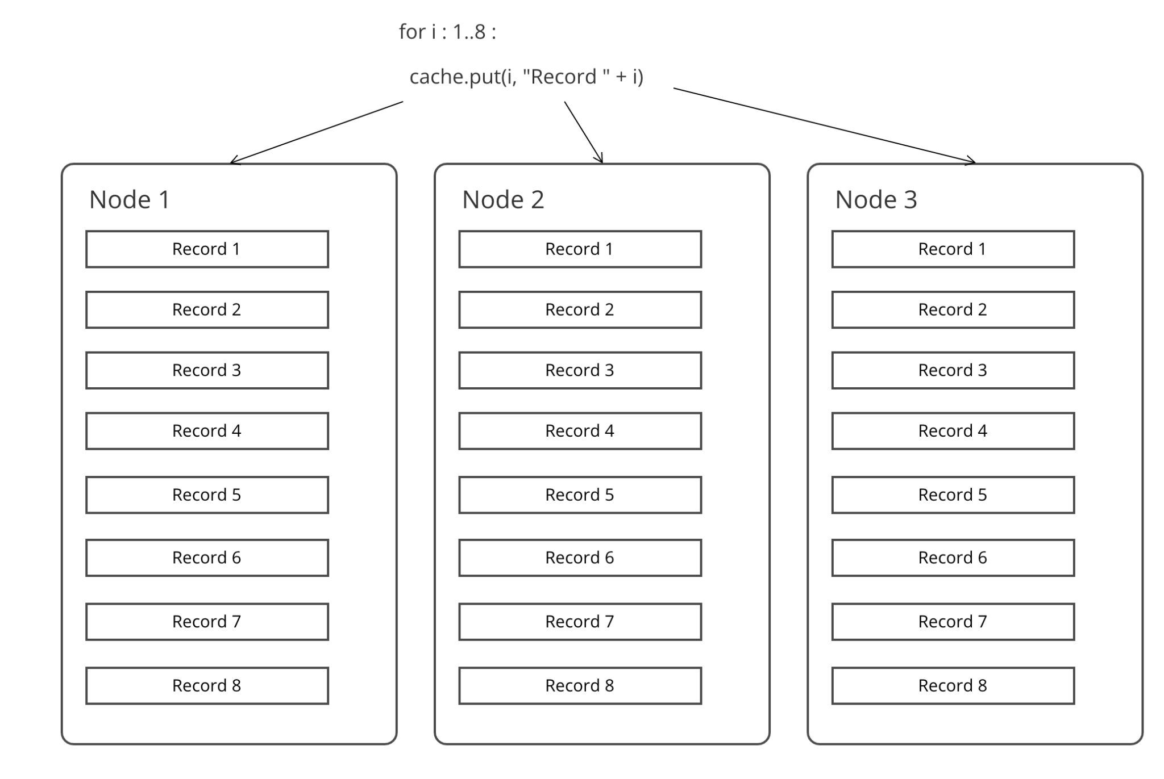
REPLICATED cache

Slide 14
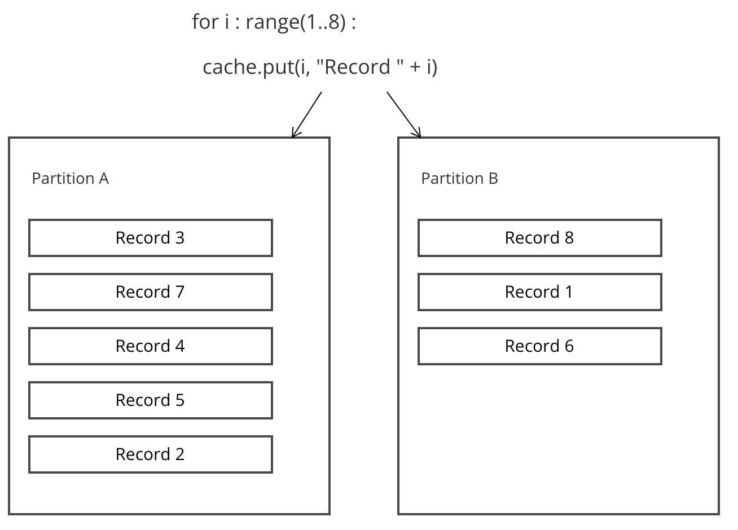
What is a partition?

Slide 15
What is a partition?
Cache consists of the set of records.
Partition is a logical subset of those records.
Partition is a _stable_ subset, once an ID is assigned to a partition, it never moves to another one.

Slide 16
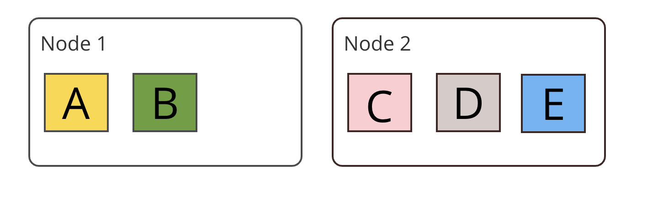
Simplest case - partitions with no back-ups

Slide 17
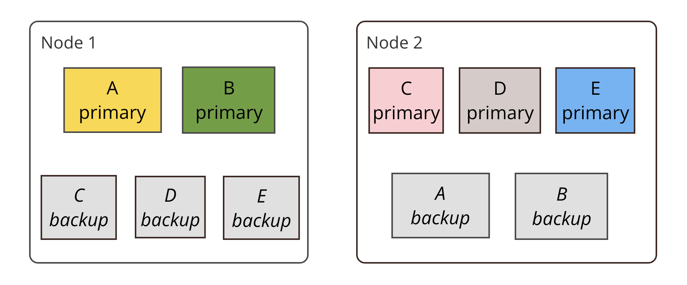
Partitions with backup
UBER RULE: a partition is never split between the nodes

Slide 18
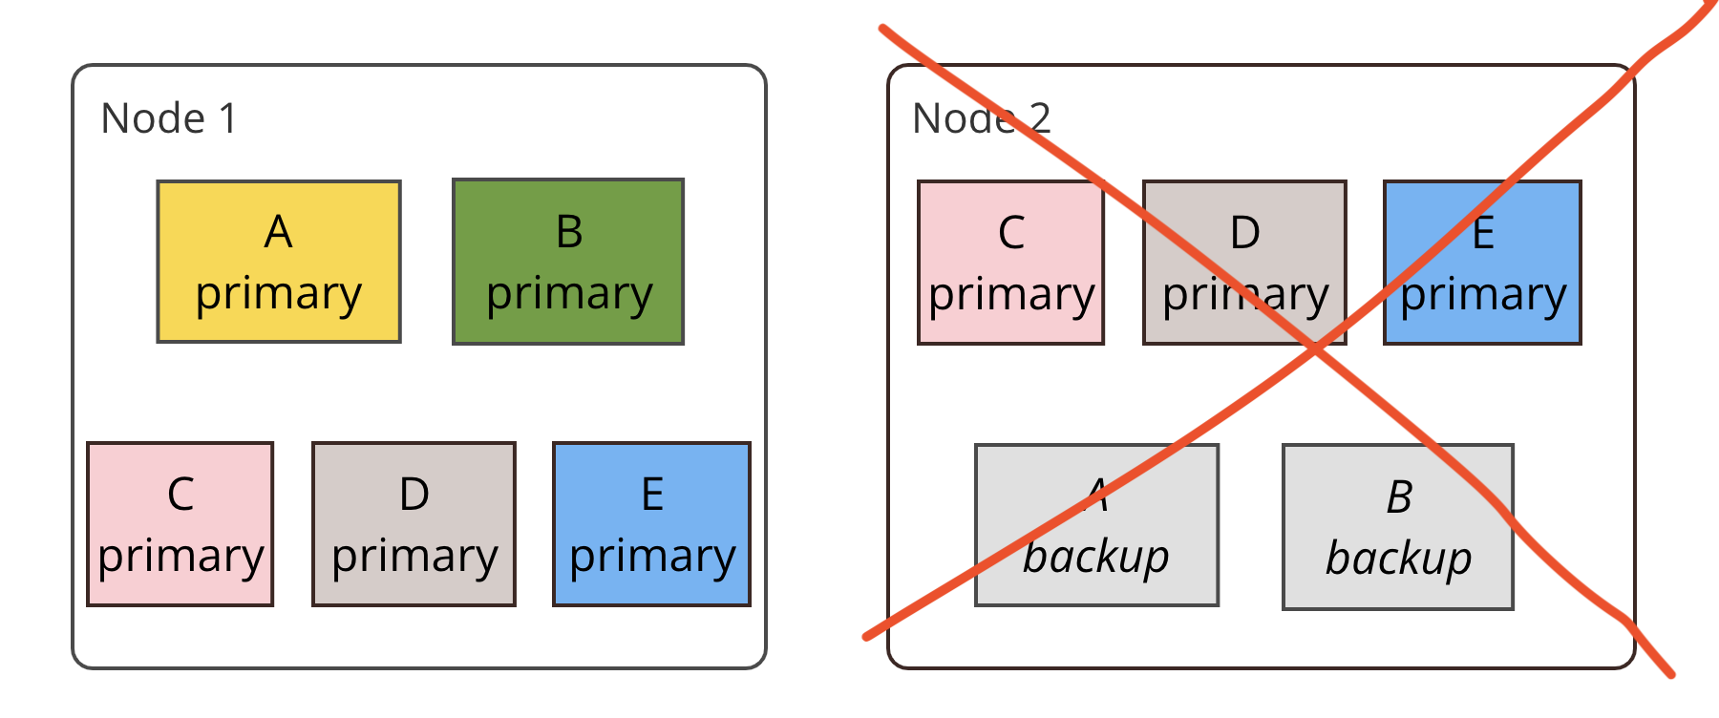
Partitions with backup - fail-over after a node killed

Slide 19
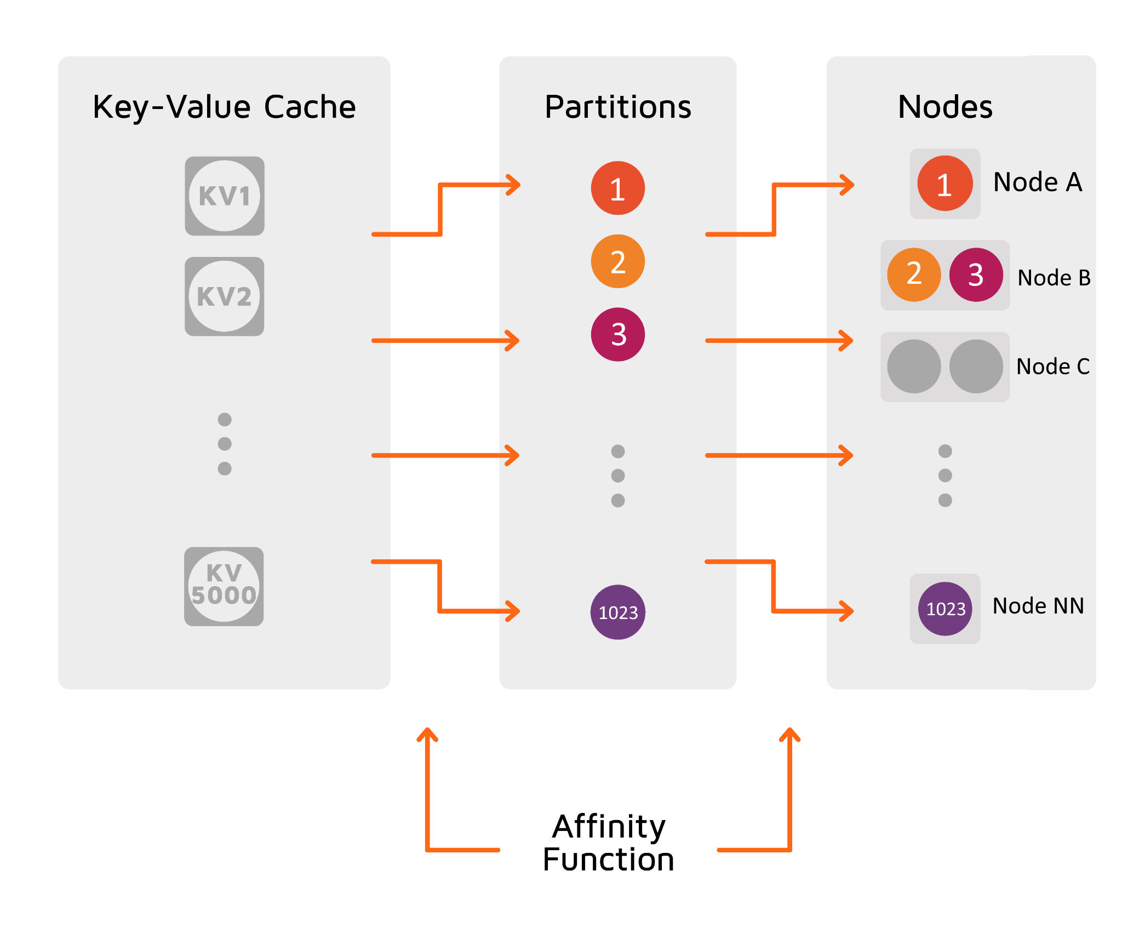
Affinity function
The affinity function determines the mapping between keys and partitions.
Partition are identified by a number from 0 to 1023.
The set of partitions is distributed between the server nodes available at the moment.
When the number of nodes in the cluster changes, the partitions are re-distributed.
The affinity function takes the affinity key as an argument.

Slide 20
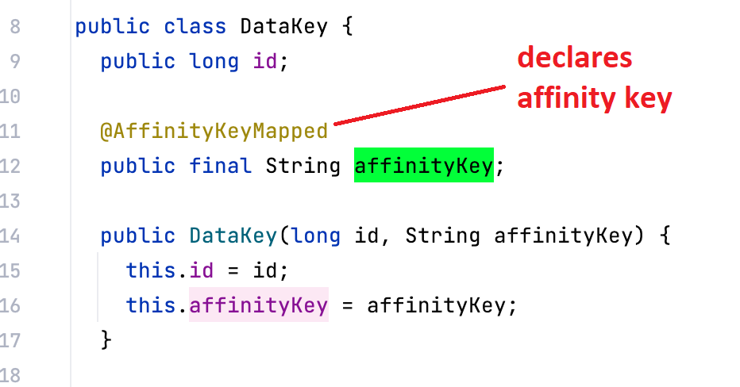
Affinity key

Slide 21
Cache with affinity key sample
(code)(code)(code)(code)(code)(code)(code)(code)(code)(code)(code)(code)(code)(code)(code)(code)(code)(code)(code)(code)(code)(code)(code)(code)(code)(code)(code)(code)(code)(code)(code)(code)(code)(code)(code)(code)(code)(code)(code)(code)(code)(code)(code)(code)(code)(code)(code)(code)(code)(code)(code)(code)(code)(code)(code)(code)(code)(code)(code)(code)(code)(code)(code)(code)(code)(code)(code)(code)(code)(code)(code)(code)(code)(code)(code)(code)(code)(code)(code)(code)(code)(code)(code)(code)(code)(code)(code)(code)(code)(code)

Slide 22
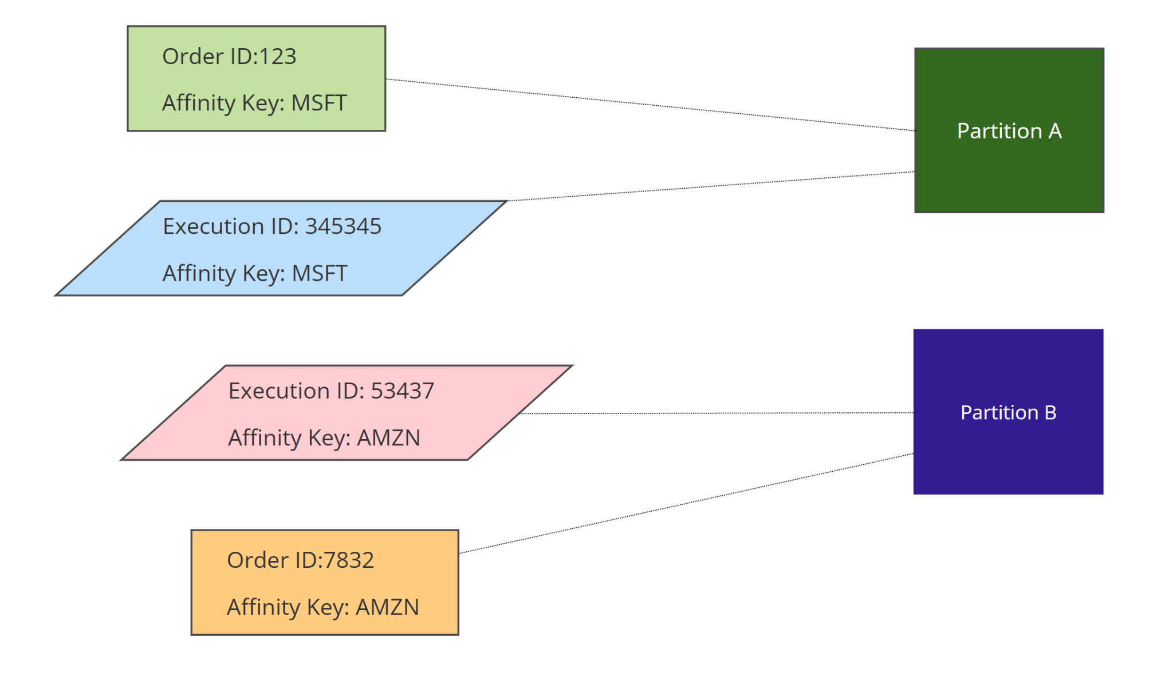
Data co-location
Affinity function looks at the affinity key only, NOT the cache type

Slide 23
Partitions with backup
UBER RULE: a partition is never split between the nodes

Slide 24
Data is colocated now

Slide 25
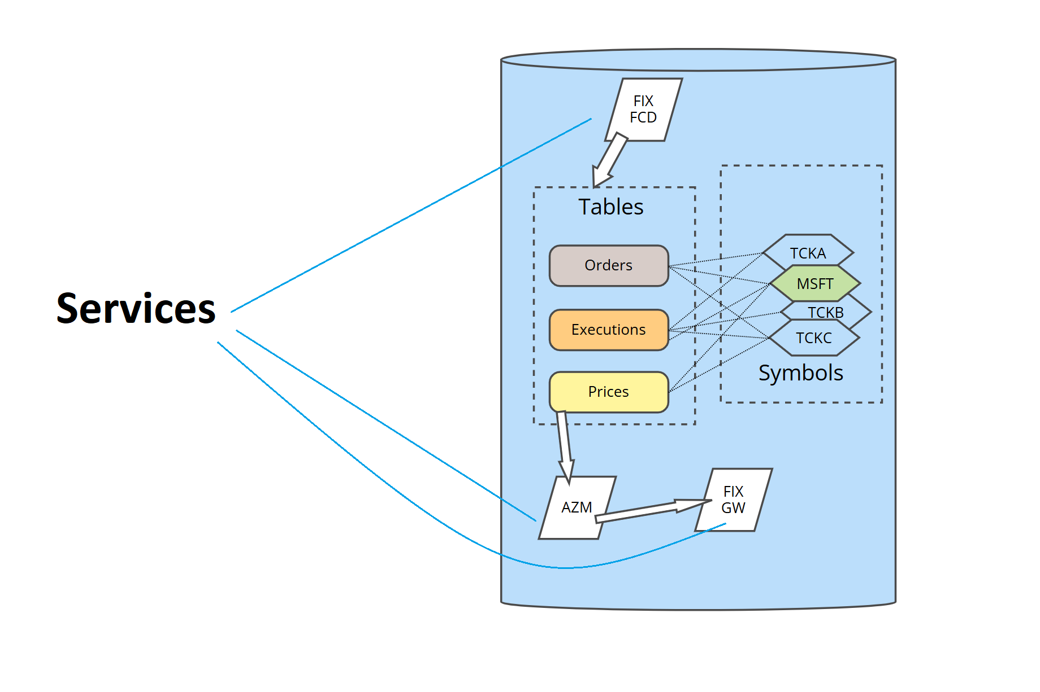
Services

Slide 26
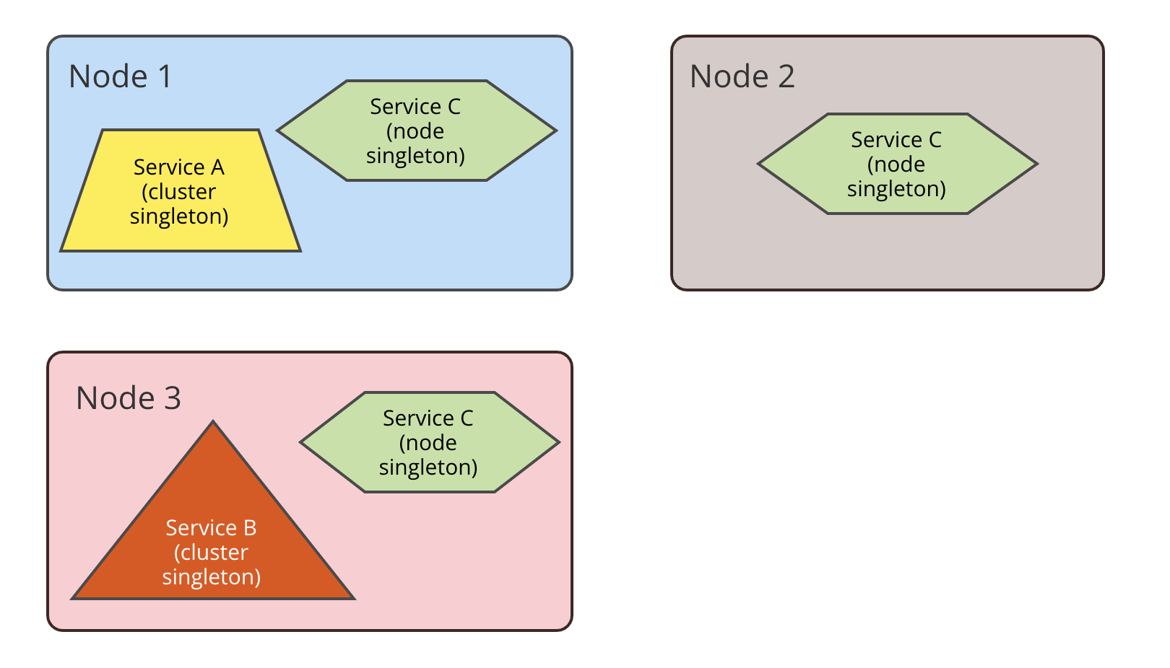
Many types of services-to-nodes-config
Cluster singleton
Node singleton
Affinity services
…

Slide 27
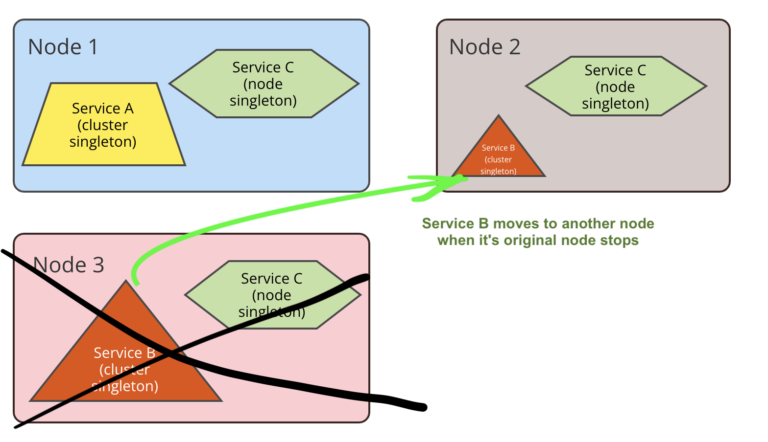
Services rebalancing

